Slide 1
Design Concepts

Slide 2
Software Design
Iterative process
Convert user requirements to blueprints which helps the programmer in software implementation.
The design model is different from requirements ; it shows the software architecture, interfaces, components & data structures used.
Initially, the represented design is the high level abstract view of system functionality and architectural details.
Later on, more iterations lead to much refined and detailed design.

Slide 3
Software Design
Software design depicts:
Architecture of the systems
Interfaces that connects end users, others systems or components of software
Software components themselves
Design is assessed by software team to check for errors, omissions, inconsistencies, other possible alternatives, constrained budgets and costs.

Slide 4
Software Design
Component level design
Defines the structural elements in procedural components that can be developed using class design
Interface design
Defines data flow between human and machine. Done using behavioral analysis and usage scenarios.
Architectural design
Defines framework of a computer based system; standalone / distributed etc.
Data / class design
Define class attributes, objects and relationship defined in CRC (class responsibility collaborator) models
Notes:
Software architecture refers to “the overall structure of the software and the ways in which that structure provides conceptual integrity for a system”

Slide 5
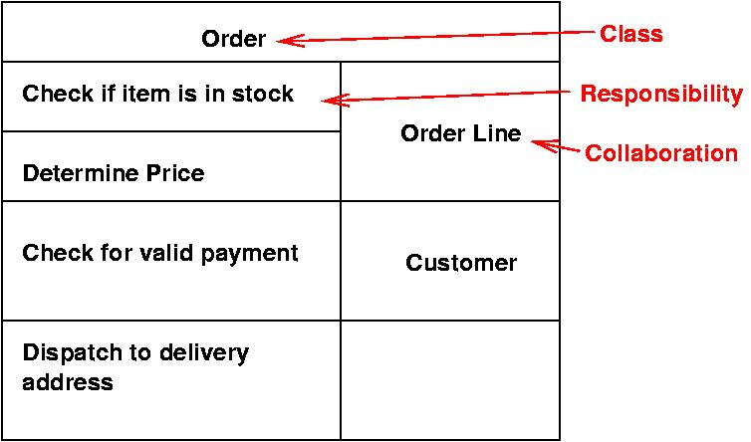



Slide 6
Good Software Design characteristics
Firmness:
Commodity:
Delight:
program should not have any bugs that inhibit its function.
A program must serve the purpose for which it is designed.
The user experience should be pleasurable one.

Slide 7
Characteristics of a good design
The design must implement all of the explicit requirements contained in the analysis model, and it must accommodate all of the implicit requirements desired by the customer.
The design must be a readable, understandable guide for those who generate code and for those who test and subsequently support the software.
The design should provide a complete picture of the software, addressing the data, functional, and behavioral domains from an implementation perspective.
All are the ultimate goal of design process

Slide 8
Quality Guidelines
A design should be modular; that is, the software should be logically partitioned into elements or subsystems
A design should contain distinct representations of data, architecture, interfaces, and components.
A design must use appropriate data structures for the classes to be implemented and are drawn from recognizable data patterns.
A design should lead to components that exhibit independent functional characteristics.
A design should lead to interfaces that reduce the complexity of connections between components and with the external environment.
A design should be derived using a repeatable method that is driven by information obtained during software requirements analysis.
A design should be represented using an understandable notation

Slide 9
Attributes for assessment of design Quality
Functionality ~ assess the capabilities of system & overall security
Usability ~ assess by considering human factors like aesthetics, consistency, documentation
Reliability ~ suggest possible severity of failures, no single point failures are appreciated
Performance ~ assessed using resource consumptions, throughput, process speed, response time
Supportability ~ ability to extend a system, lesser system limitations are good
Maintainability ~ system installation and maintenance should be done easily

Slide 10
software design Evolution
Initially modular approach used ~ structured programming
Develop using top-down manner
Later advances and involvement of data structures and reusability and dataflow reshaped it to object oriented programming paradigm.
Now the design approaches are moving for test driven developments

Slide 11
How to make an effective design
Problem partitioning
Define functions, modules and multiple products that could operate separately
Abstraction
Show only the upper level details of the requirements, hide implementation details
Top down / bottom up approach used
Top down used for reverse engineering problems -> you have a defined product and you need to customize it as per your needs
Bottom up -> you know modules / subsystems, you integrate them and make up final product
Notes:
Reverse engineering, sometimes called back engineering, is a process in which software, machines, aircraft, architectural structures and other products are deconstructed to extract design information from them.

Slide 12
Fundamental Concepts
Abstraction—data, procedure, control
Architecture—the overall structure of the software
Patterns—”conveys the essence” of a proven design solution
Separation of concerns—any complex problem can be more easily handled if it is subdivided into pieces
Modularity—compartmentalization of data and function
Hiding—controlled interfaces
Functional independence—single-minded function and low coupling
Refinement—elaboration of detail for all abstractions
Aspects—a mechanism for understanding how global requirements affect design
Refactoring—a reorganization technique that simplifies the design
OO design concepts—Appendix II
Design Classes—provide design detail that will enable analysis classes to be implemented

Slide 13
Abstraction
Abstraction
In modular approaches we have multiple level of abstractions
The Higher the level, more the abstraction is
Lower level shows the implementation details
Data abstraction -> hiding attributes of an entity
Procedural abstraction -> hide process details

Slide 14
Data Abstraction
door
manufacturer
model number
type
swing direction
inserts
weight
opening mechanism
implemented as a data structure

Slide 15
Procedural Abstraction
open
details of enter
algorithm
implemented with a "knowledge" of the
object that is associated with enter

Slide 16
Architecture
Architecture
Software architecture refers to “the overall structure of the software and the ways in which that structure provides conceptual integrity for a system”
It defines the components of a system and the manner in which those components are packaged and interact with one another.
It should address how the design architecture achieves requirements for performance, capacity, reliability, security, adaptability and other system characteristics.
It should have the ability to reuse architectural building blocks.

Slide 17
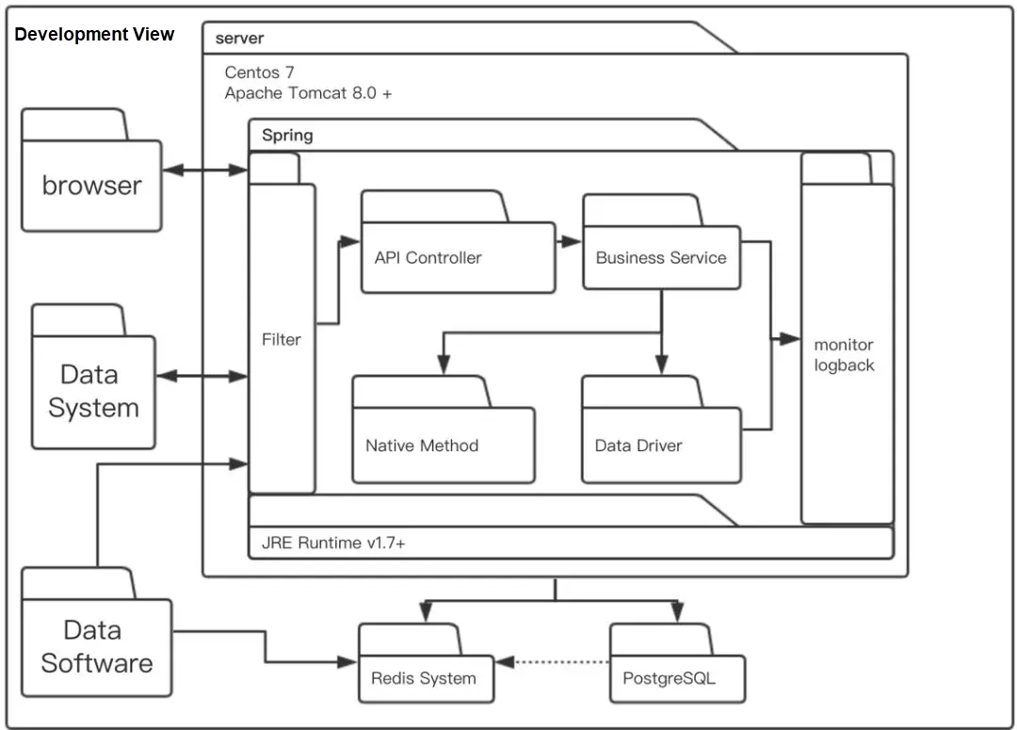

Slide 18
Patterns
Pattern
“A design pattern is a proven solution (design structure) to a recurring (design) problem within a certain context amid competing concerns”.

